Slide 1
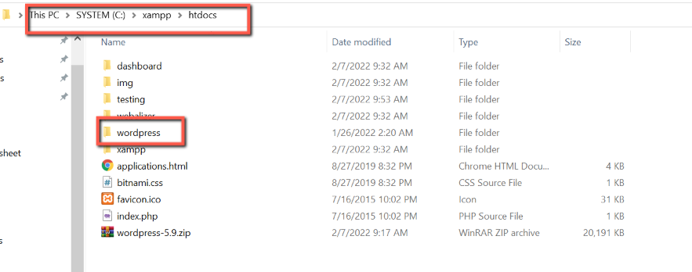
Extract WP Zip (…/xampp/htdocs)

Slide 2
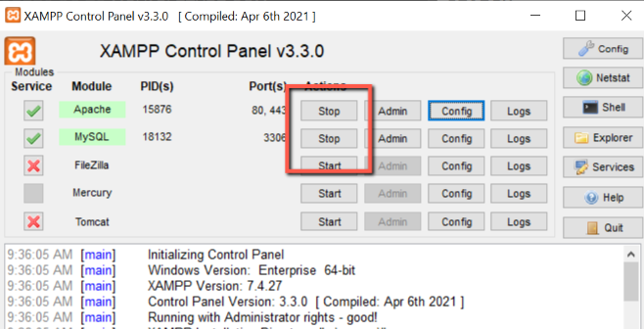
Start Apache and MySQL from xampp control panel

Slide 3
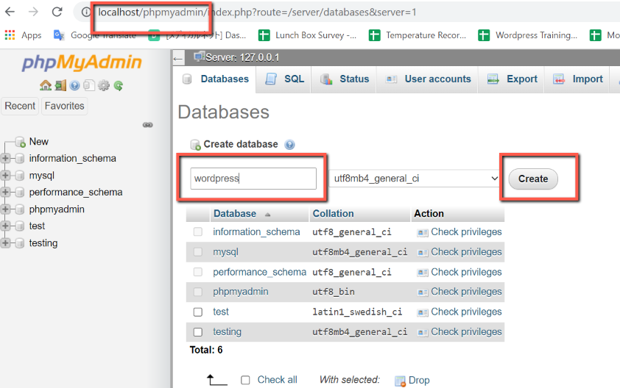
Create database - localhost/phpMyAdmin - insert database name ( in this picture wordpress is database name) - click create

Slide 4
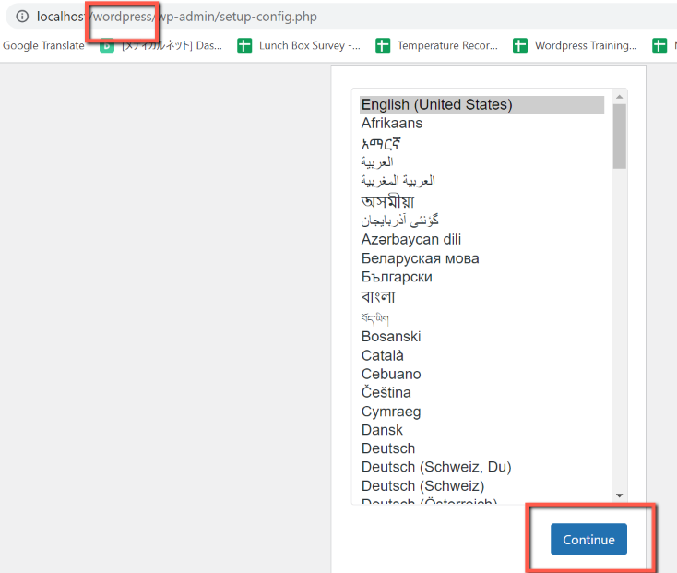
WP install - localhost/your folder name from htdocs file (in this picture wordpress is folder name) - Click Continue

Slide 5
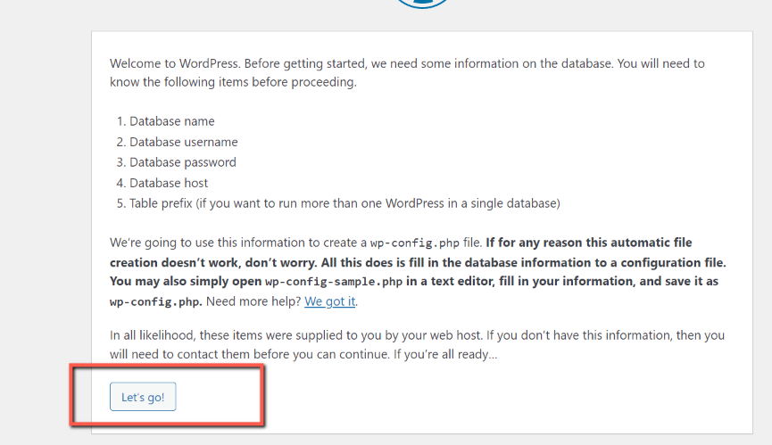
WP install - Click Let’s Go

Slide 6
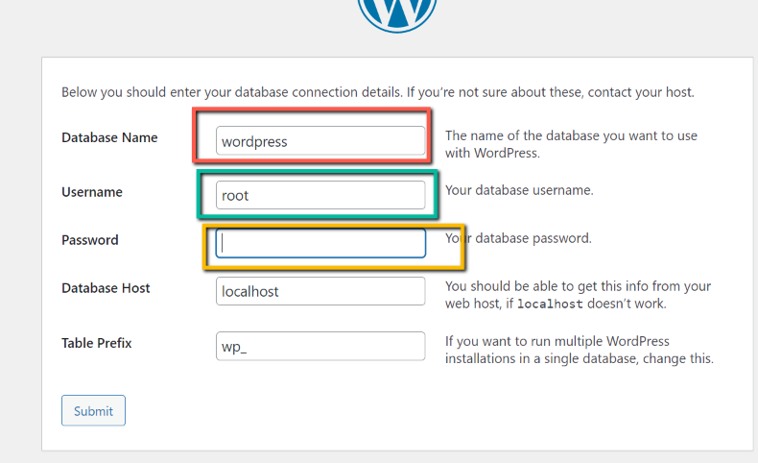
WP install - Database Name : created database name - User name : root (if xampp) - Password : blank (if xampp) - Click Submit

Slide 7
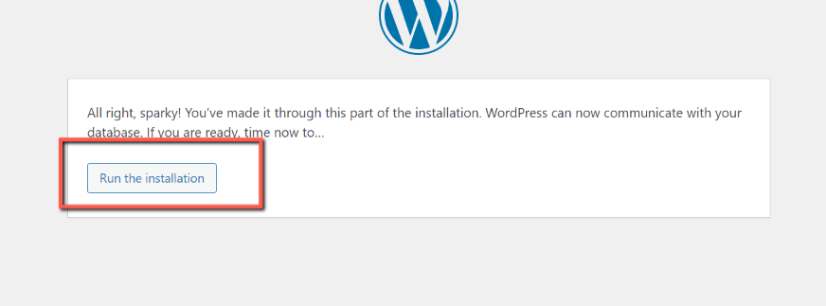
WP install - Click Run the installation

Slide 8
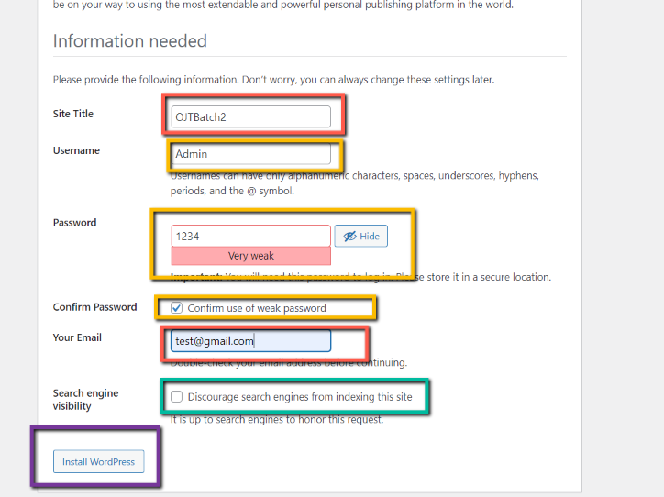
WP install - Site Title : your website title - User name : insert name (as you like) for your admin dashboard login - Password : insert ….. (as you like) for your admin dashboard login - Your email : insert email (as you like) for your website - green frame : no need to check - Click Install WordPress

Slide 9
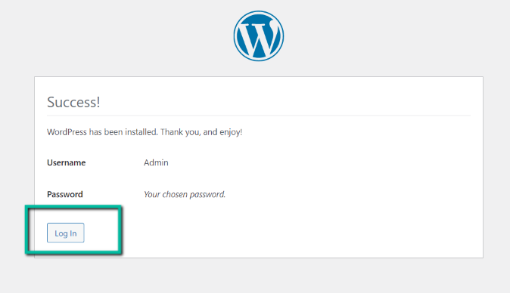
WP install - Installation finish - Click login for visit your website dashboard

Slide 10
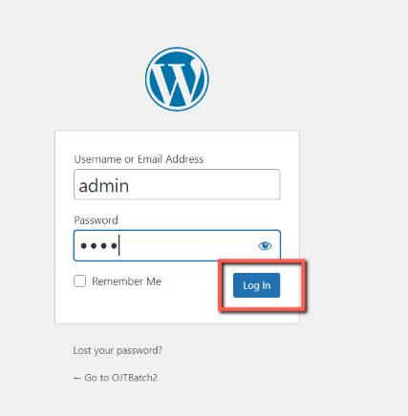
WP Login - Insert username and password from Slide no.6

Slide 11
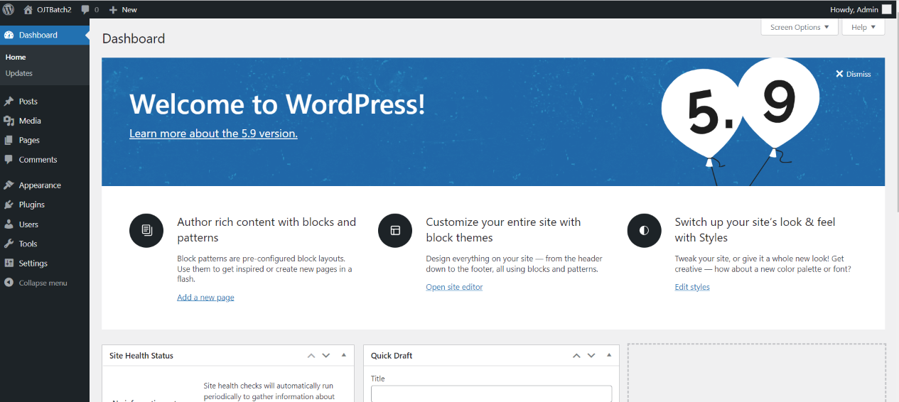
WP Dashboard - welcome your dashboard - Thanks !!!!

